Slide 1
SPC Final Recognition: Ignoring IFR
Parsed by NaN Count
No NaN: 0 NaNs Per Session
Mid-Low NaN: 16 NaNs Per Session
Mid-High NaN: 56 NaNs Per Session
High NaN: 96 NaNs Per Session

Slide 2
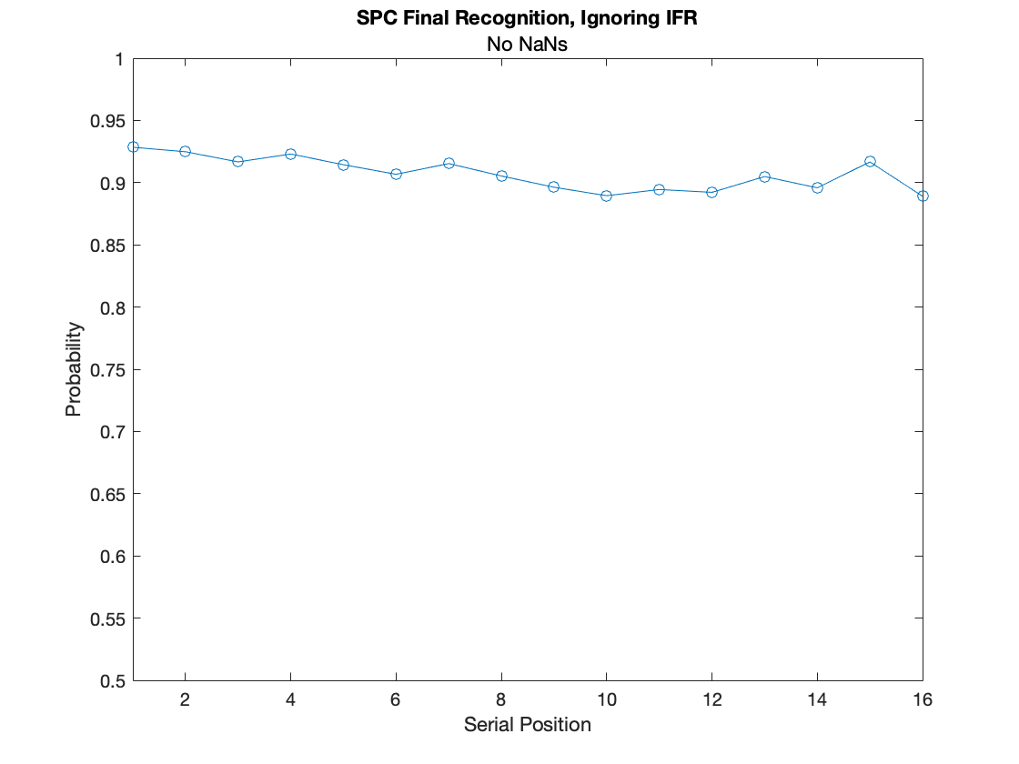
SPC Ignoring IFR: No NaNs

Slide 3
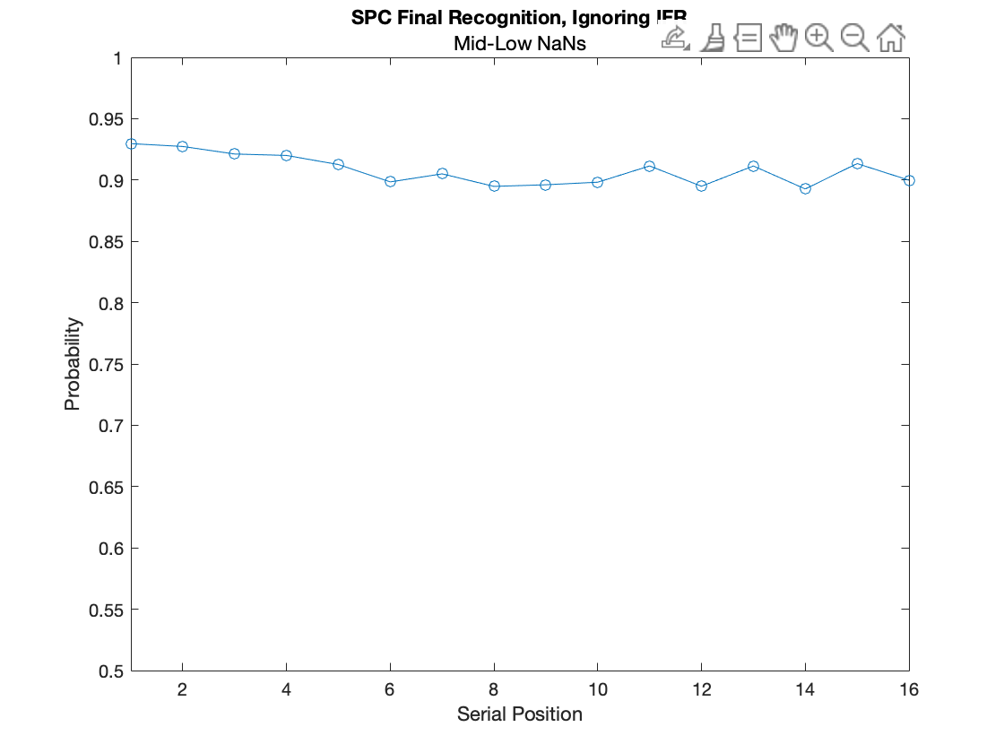
SPC Ignoring IFR: Mid-Low NaNs

Slide 4
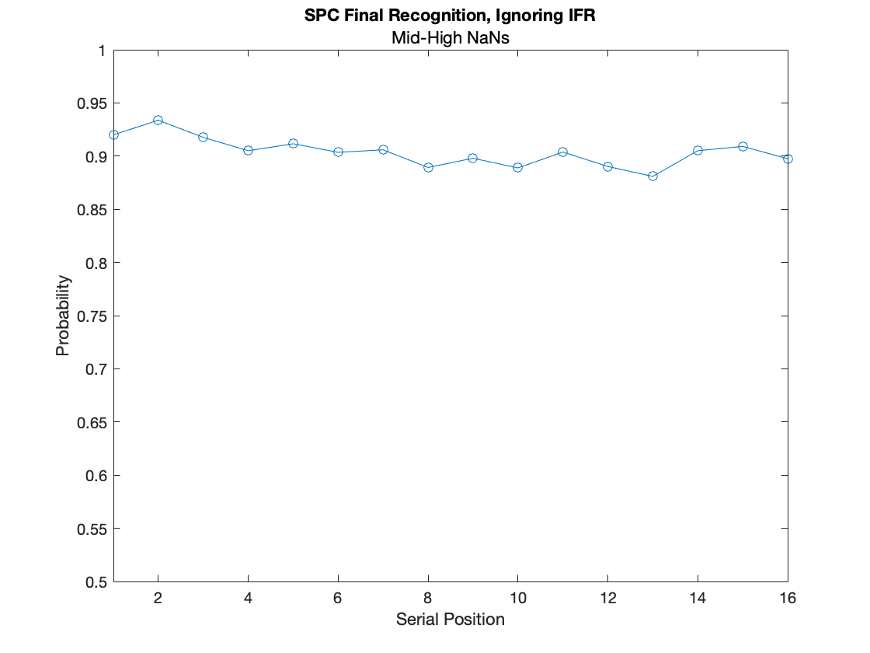
SPC Ignoring IFR: Mid-High NaNs

Slide 5
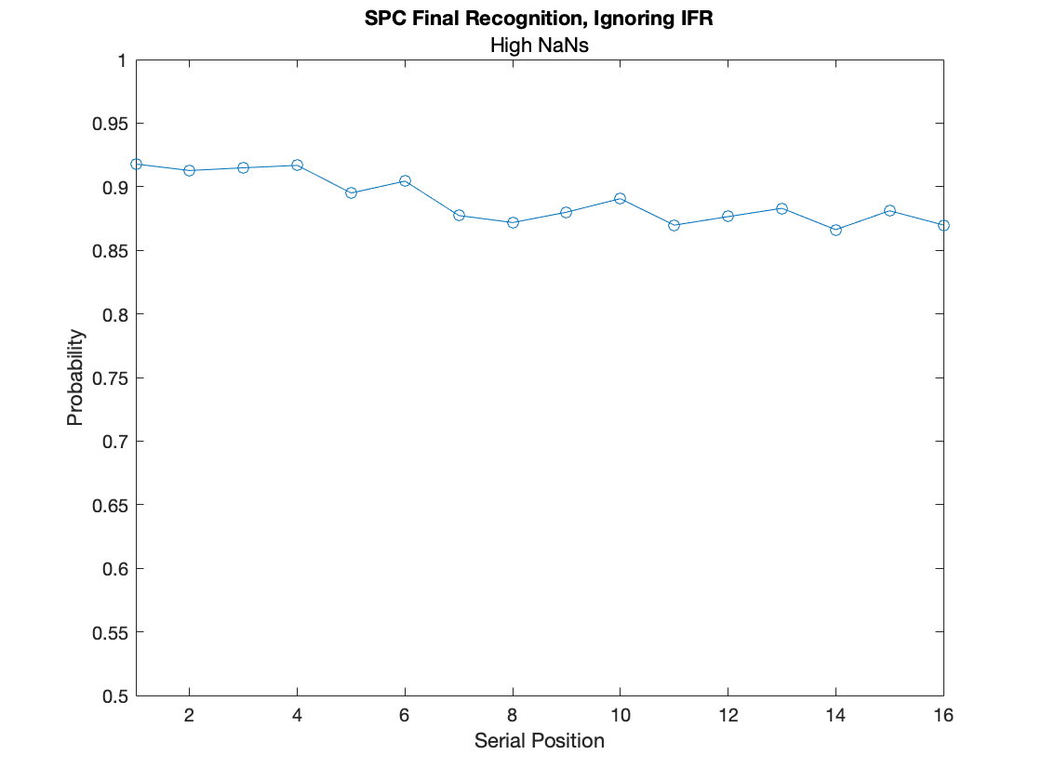
SPC Ignoring IFR: High NaNs

Slide 6
SPC Final Recognition: Conditional on IFR
Parsed by NaN Count
No NaN: 0 NaNs Per Session
Mid-Low NaN: 16 NaNs Per Session
Mid-High NaN: 56 NaNs Per Session
High NaN: 96 NaNs Per Session

Slide 7
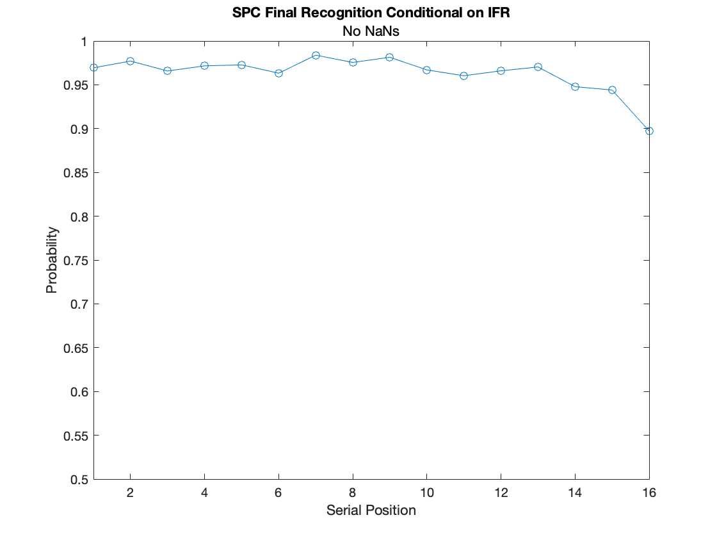
SPC Conditional on IFR : No NaNs

Slide 8
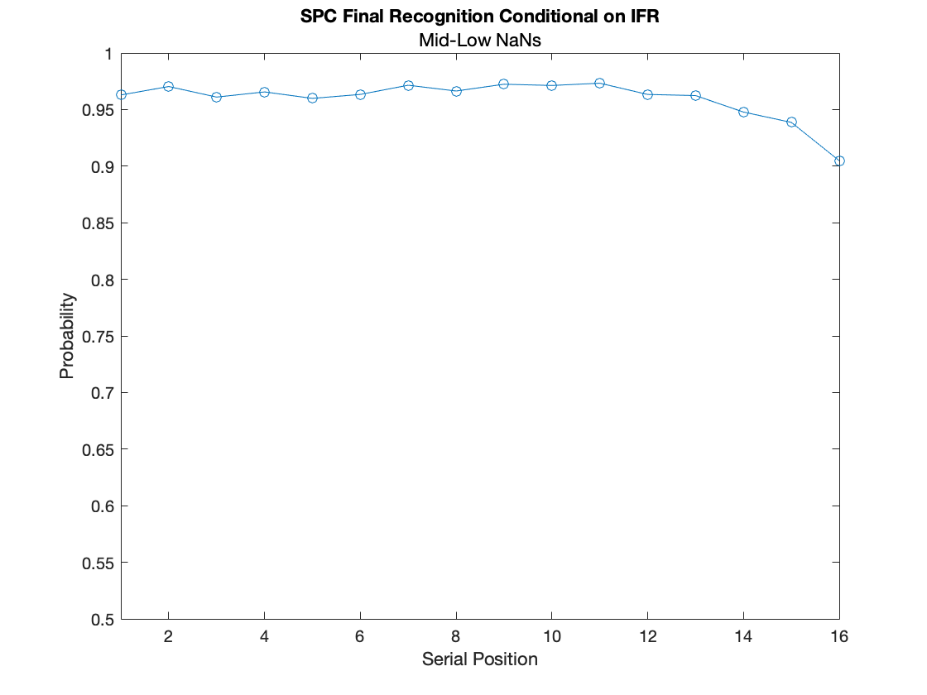
SPC Conditional on IFR : Mid-Low NaNs

Slide 9
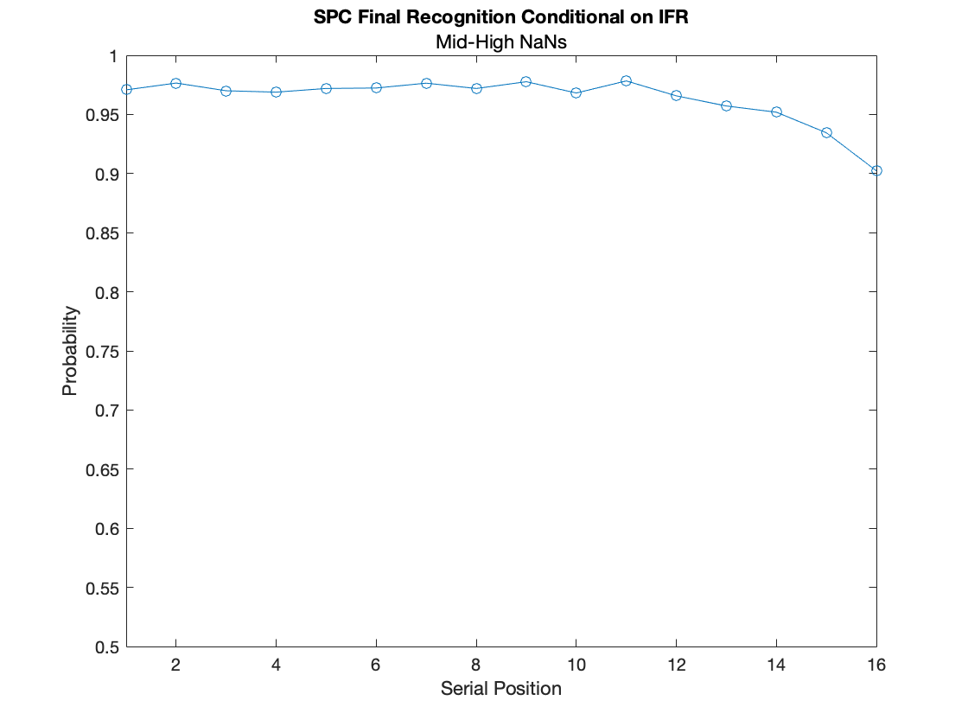
SPC Conditional on IFR : Mid-High NaNs

Slide 10
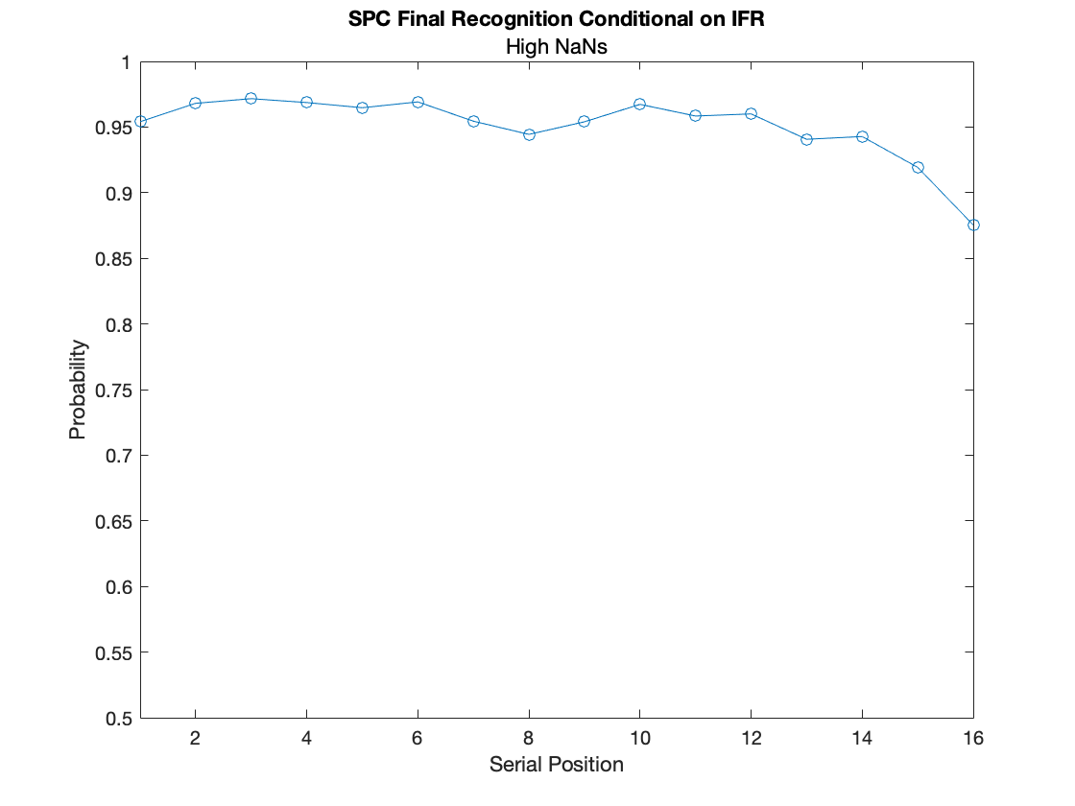
SPC Conditional on IFR : High NaNs

Slide 11
SPC Final Recognition: Excluding IFR Items
Parsed by NaN Count
No NaN: 0 NaNs Per Session
Mid-Low NaN: 16 NaNs Per Session
Mid-High NaN: 56 NaNs Per Session
High NaN: 96 NaNs Per Session

Slide 12
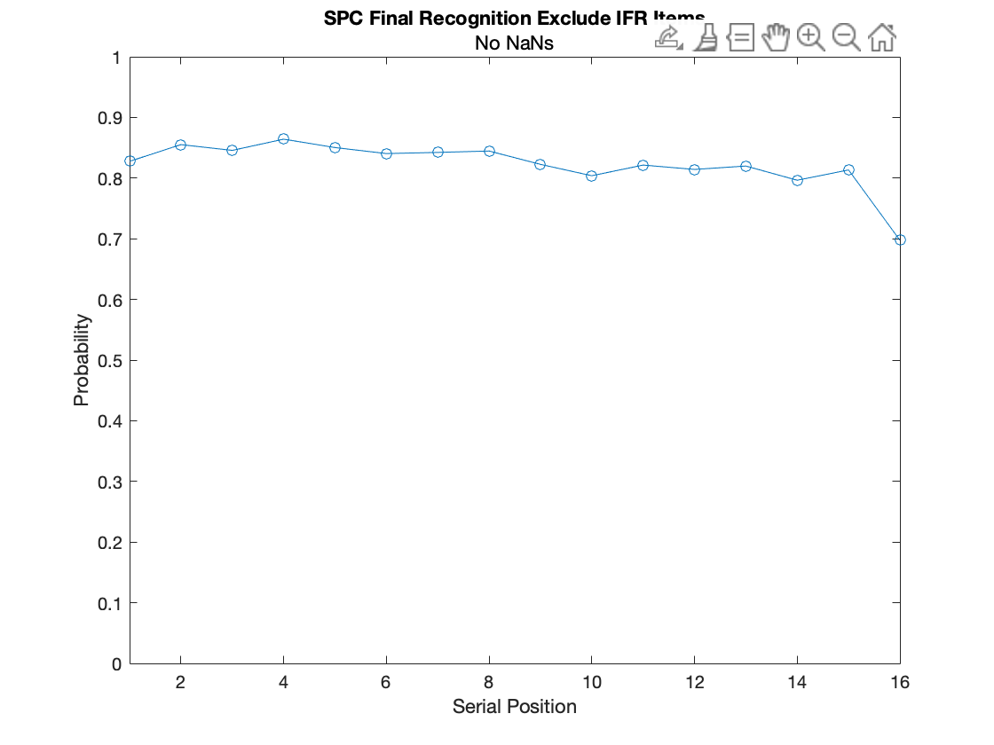
SPC Exclude IFR: High NaNs

Slide 13
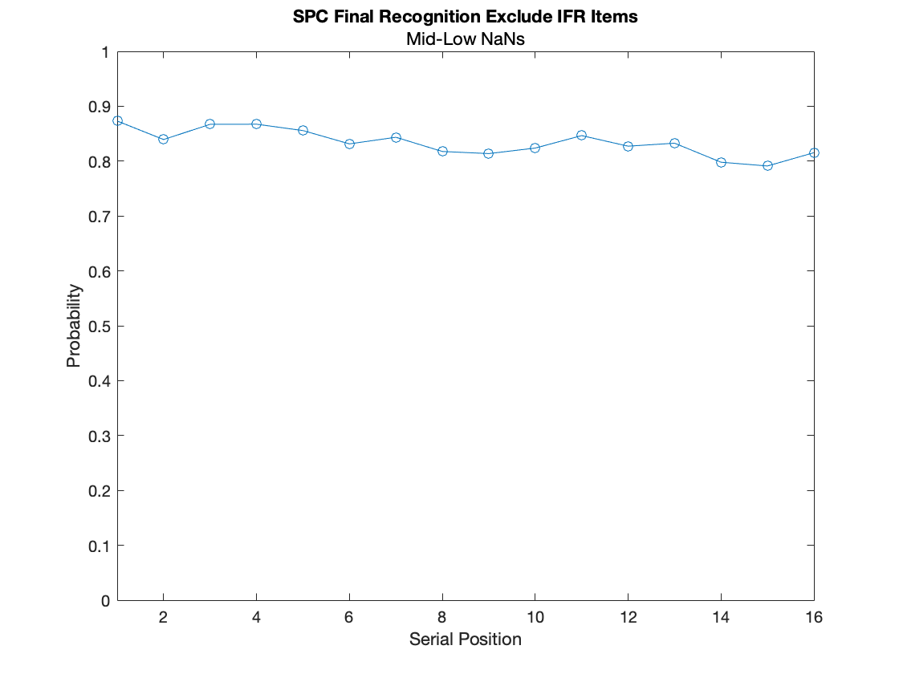
SPC Exclude IFR: High NaNs

Slide 14
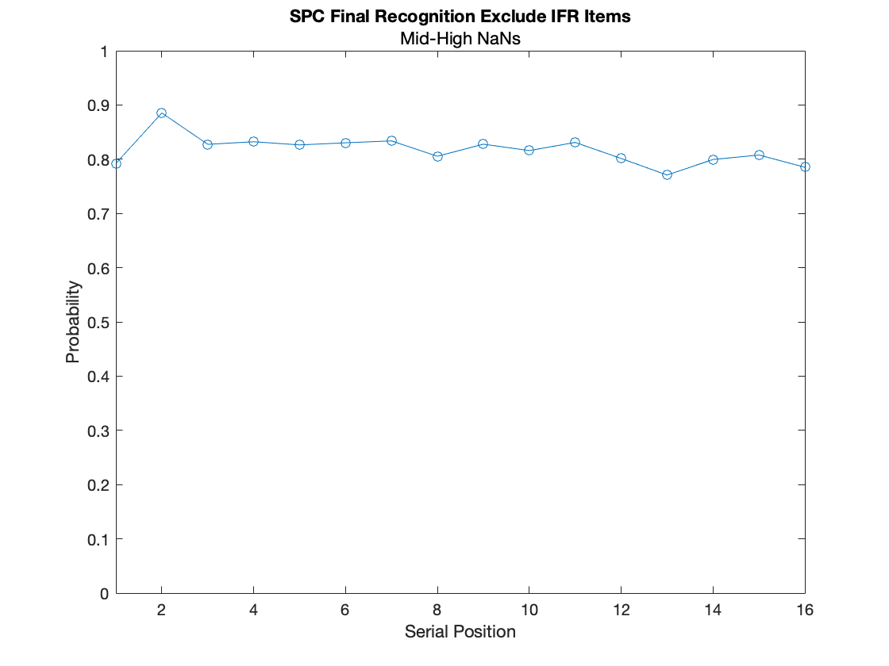
SPC Exclude IFR: High NaNs

Slide 15
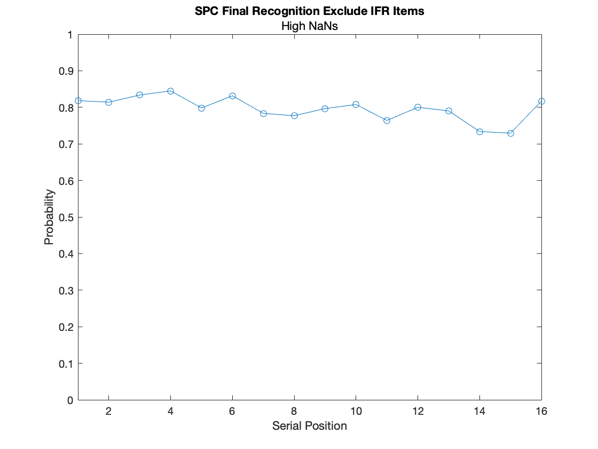
SPC Exclude IFR: High NaNs

Slide 16
Corrections For SPC FR Excluding IFR Items
The only correction made to my original code (predictors_recognition_07192021.m) was that I used recognition2 as a variable with successfully retrieved IFR items to be masked out and left the recognized variable alone.
You can find this changes in the version history on Github starting at line 942, but I’ve included an explanation with the specific, extracted lines of code + comments on the following 2 slides.

Slide 17
Inaccuracy in Original Code
%I found a cleaner way to do this in my new script
%But it doesn’t change the outcome.
was_recalled= recitemnos(recitemnos>0);
%Match the pres_itemnos that match IFR rec_itemnos
%Originally, I had intended for recognized2 to be the conditional variable for IFR Only and just use “recognized” for Not IFR;
recognized2= recognized;
recognized2(~ismember(presitemnos, was_recalled))=nan;
%However, using recognized as a comprehensive mask is not correct for the Excluding IFR analysis
recognized(ismember(presitemnos, was_recalled))= nan;
for i = 1:LL
fr_num_sp(i)= sum(sum(recognized(:,i)==1)); %The way that I was calculating the numerator was fine
fr_denom_sp(i)= sum(sum(~isnan(recognized(:,i)))); % This was the problem, this was counting all the successfully recalled items as NaNs. There were a small number of items e.g., recall= = 0 & recognized = = 0 or 1 that were still counted here, which is why the proportion wasn’t all 1’s.
end

Slide 18
Corrections in New and Old Code
%Find rec_itemnos for IFR items
was_recalled= recitemnos(recitemnos>0); %I found a cleaner way to do this in my new script
%But it doesn’t change the outcome.
%Create a copied version of the recognized variable for numerator, masking out not recalled items
recognized2= recognized;
%If an item was recalled and is in presitemnos, set it to 0
recognized2(ismember(presitemnos, was_recalled))= nan;
for i = 1:LL
fr_num_sp(i)= sum(sum(recognized2(:,i)==1));
%Denominator taken out of all possible opportunities i.e.
%Unlike recognized2, recognized only masks out items that were not tested
fr_denom_sp(i)= sum(sum(~isnan(recognized(:,i))));
end

Slide 19
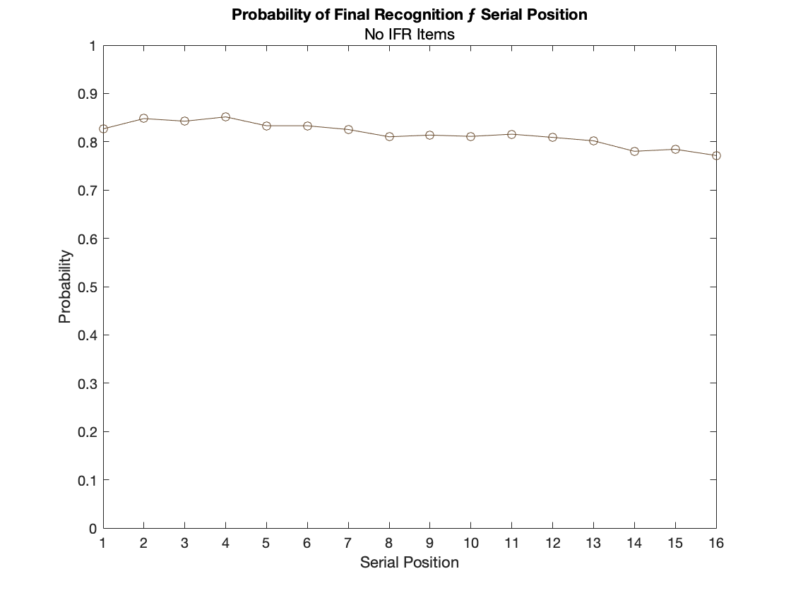
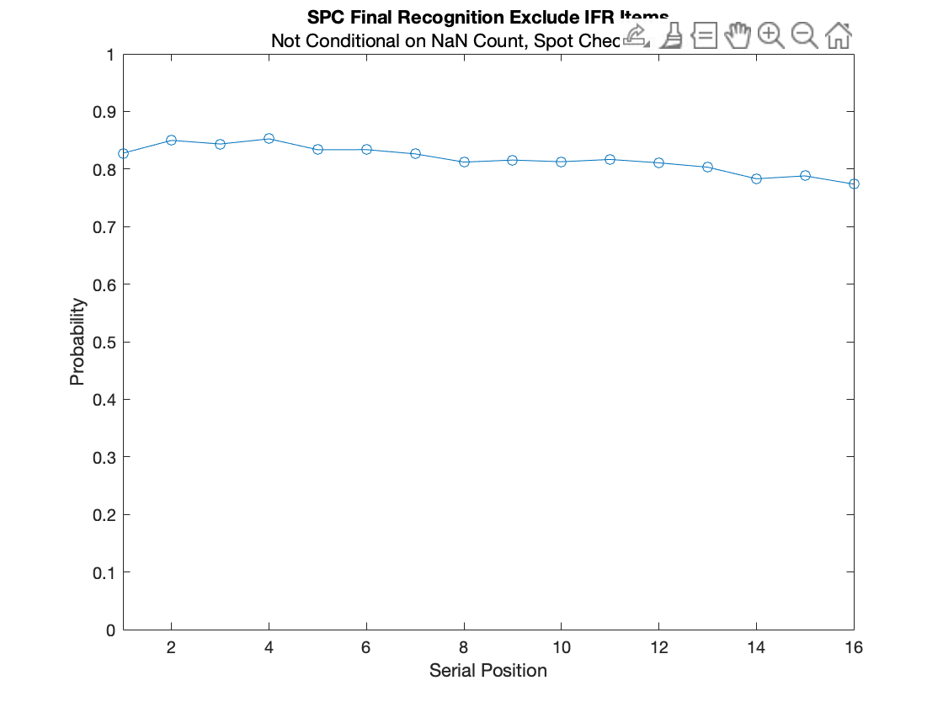
SPC Exclude IFR: Not Grouped by NaN Count
Old Code With Correction
New Code (Spot Checking)

Slide 20
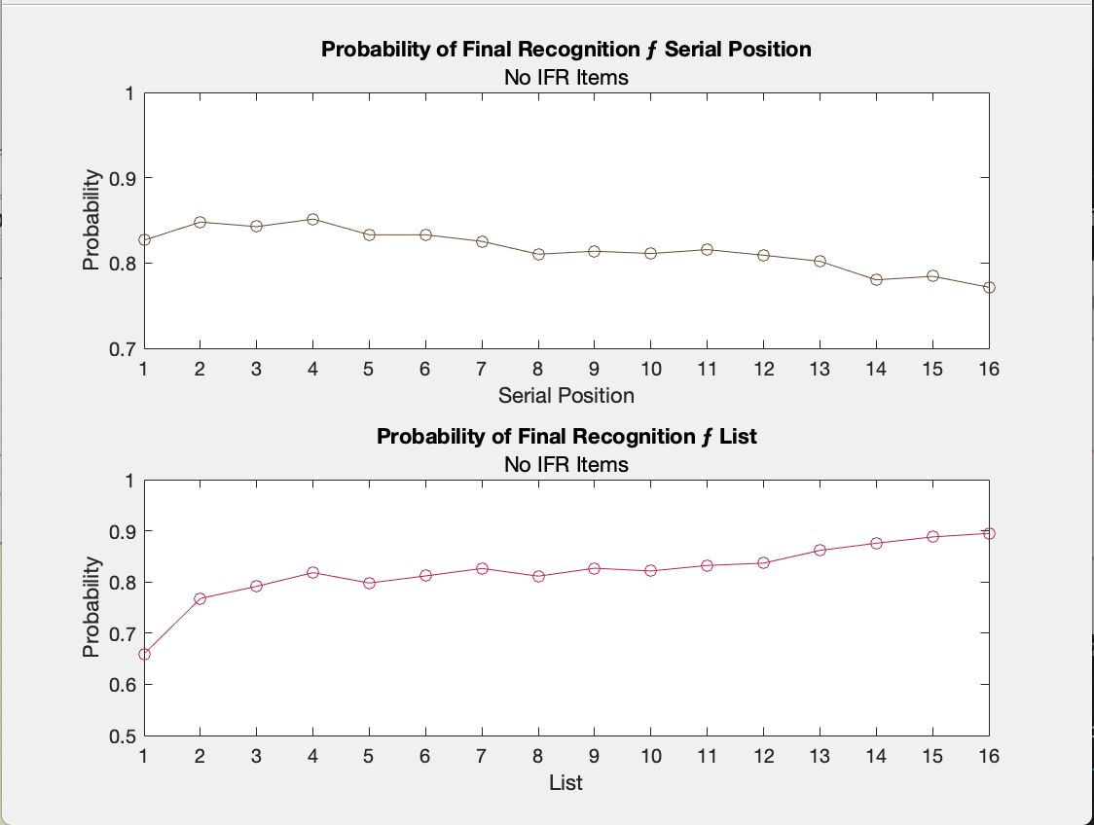
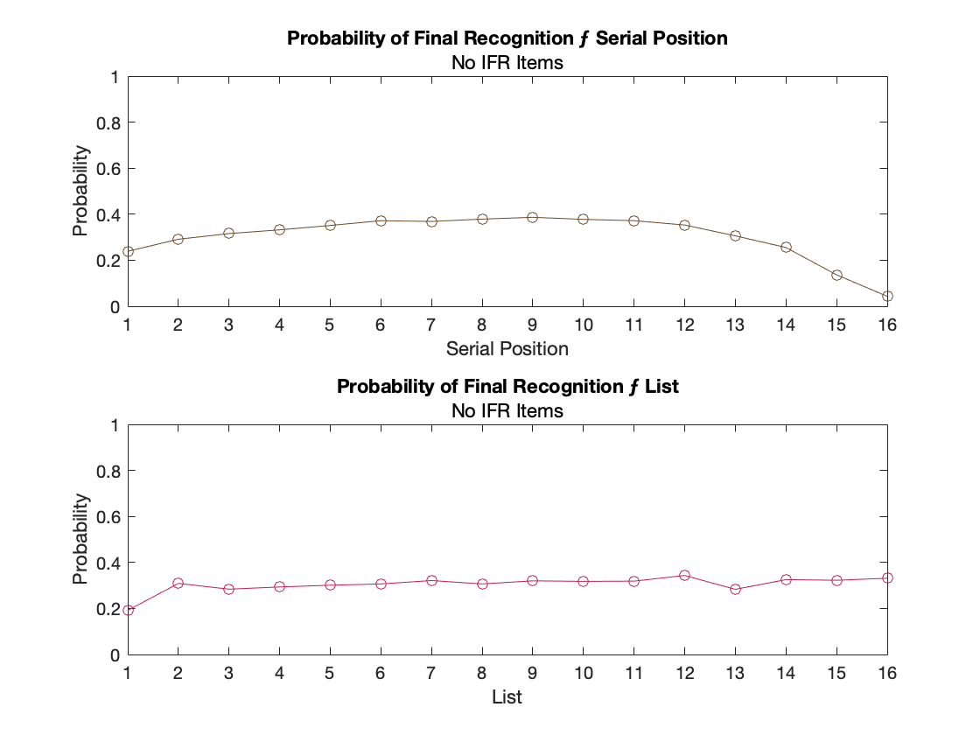
Corrected Version of Previous SPC FR: Exclude IFR Plot
Old Code Without Correction
Old Code With Correction

